Slide 1
Software for Social Good

Slide 2
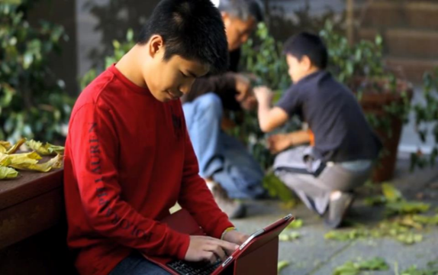
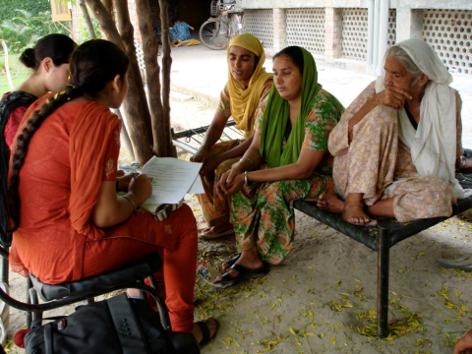
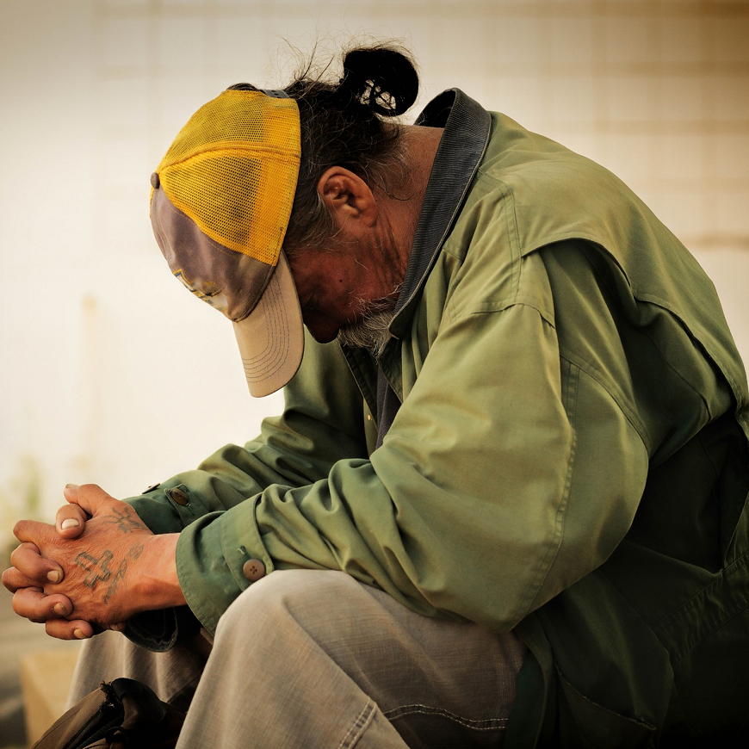
Our work
GLOBAL EDUCATION and LITERACY
HUMAN RIGHTS
We empower communities
with software
for social good
POVERTY ALLEVIATION

Slide 3
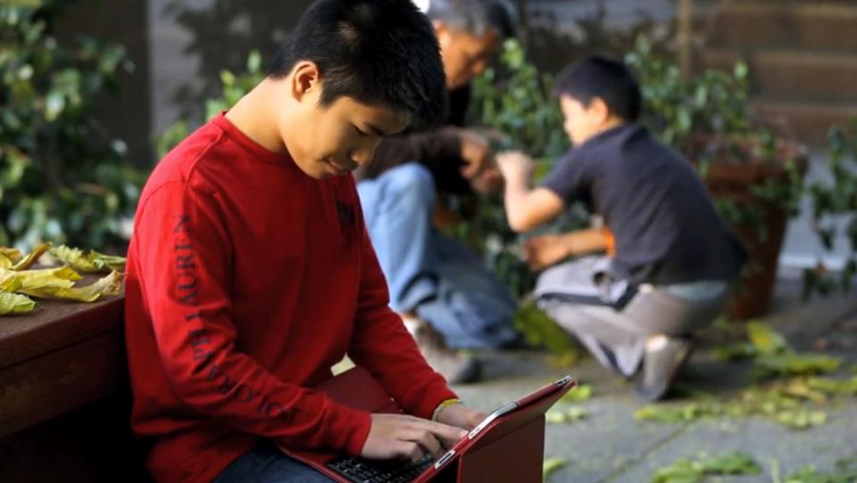
Bridge
We serve as a bridge between the social sector and Silicon Valley to
drive lasting social change

Slide 4


Bookshare Statistics
15 Million+ accessible ebooks delivered
700,000 Bookshare users
780,000+ Books
870 publisher partners
47 languages

Slide 5
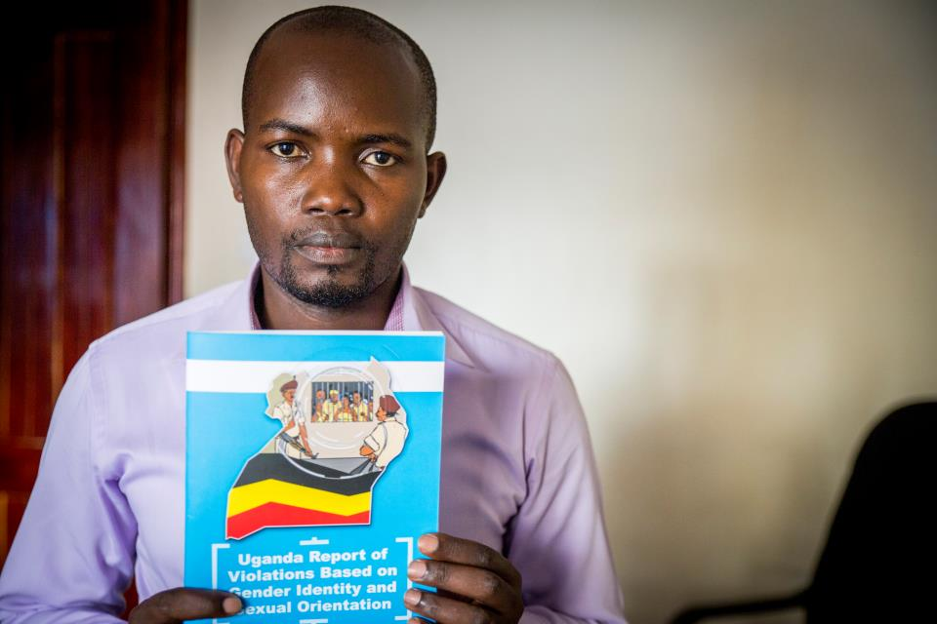
Human Rights
50+ Countries
Thousands of human rights activists securely documented violations

Slide 6
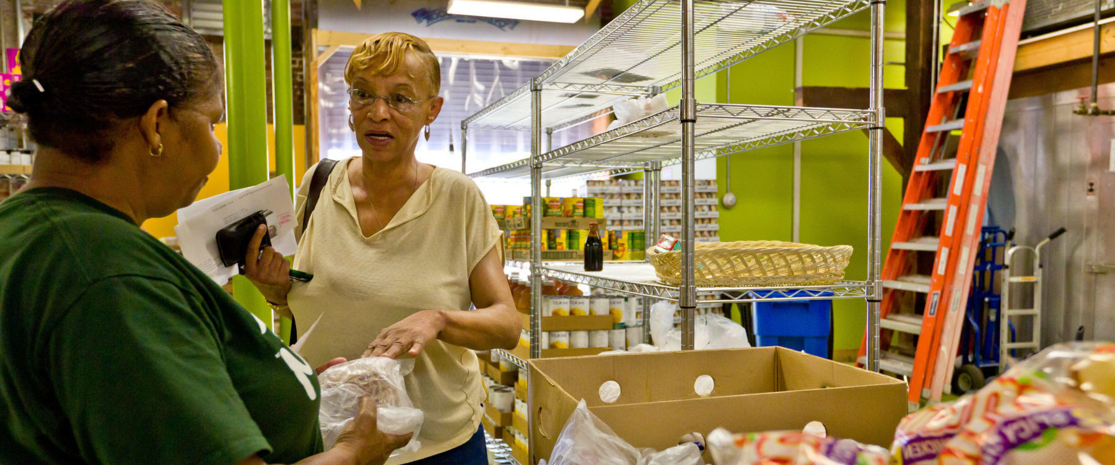
Human Services
1.7 Million
People in the Bay Area with better access to human services*
*Projected

Slide 7
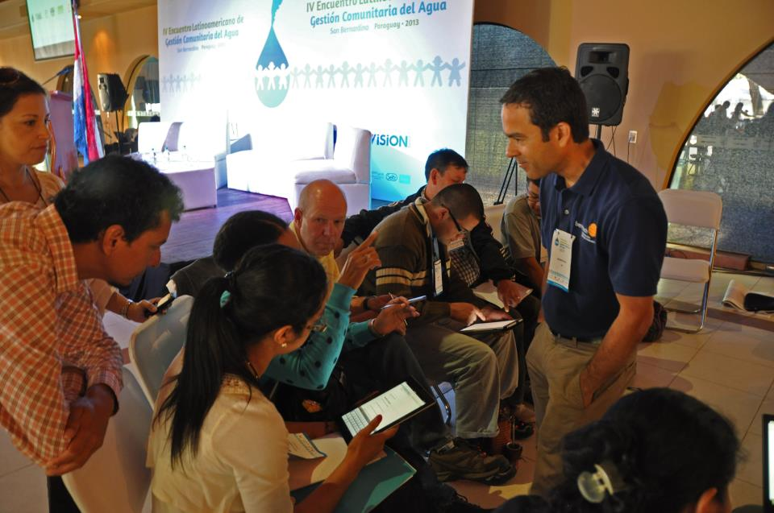
Community Outreach
We advise, build and foster the software for social good ecosystem.

Slide 8



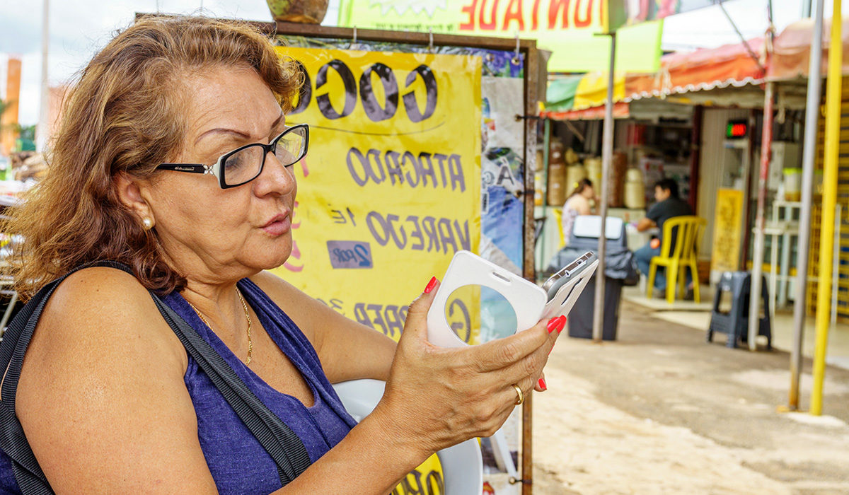
Empowering Inclusive Access to Opportunities with Software
Bookshare: Access to information for those with reading barriers
Members can access a huge collection of ebooks and read their way
DIAGRAM Center: Building new paths to accessibility
A research and development center that creates tools, standards and best practices to support different learning needs.
Benetech Service Net: Strengthening the social safety net
Data exchange platform that allows for more accurate, timely, and cost-effective management of social services resource information.
Data for Inclusion: Giving people with disabilities a voice as they seek employment and education
People with disabilities and disabled persons’ organizations can provide firsthand reports of the issues they face.

Slide 9

Born Accessible
Introduced “Born Accessible” and “Buy Accessible” guidelines
If a book can be born digital, it can be Born Accessible
Now helping to set accessibility
“gold standard” for publishers

Slide 10
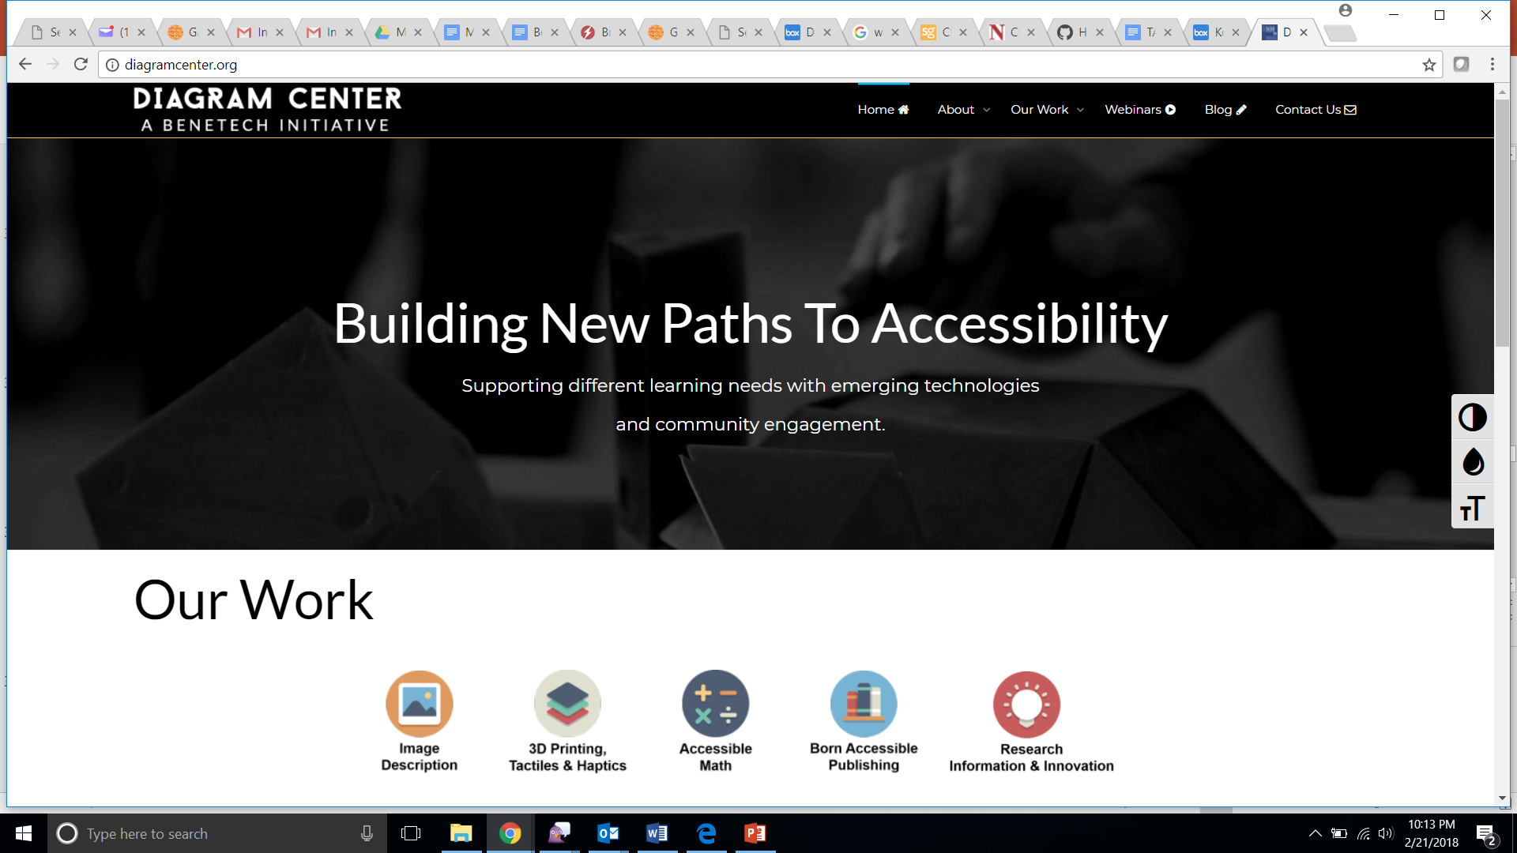
diagramcenter.org
Building tools and best practice examples, establishing new standards, and finding ways to share our resources to make education accessible for all

Slide 11
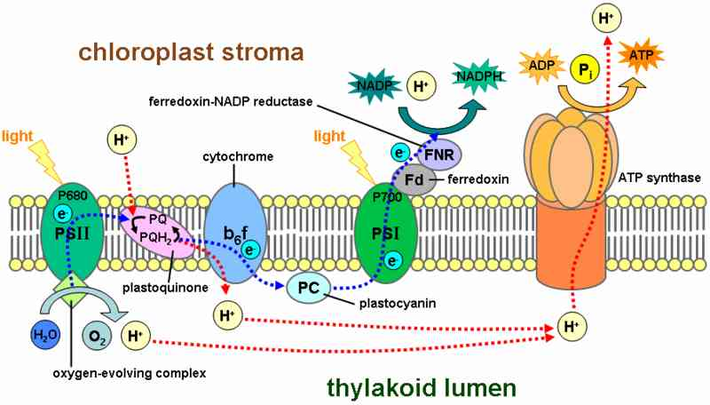
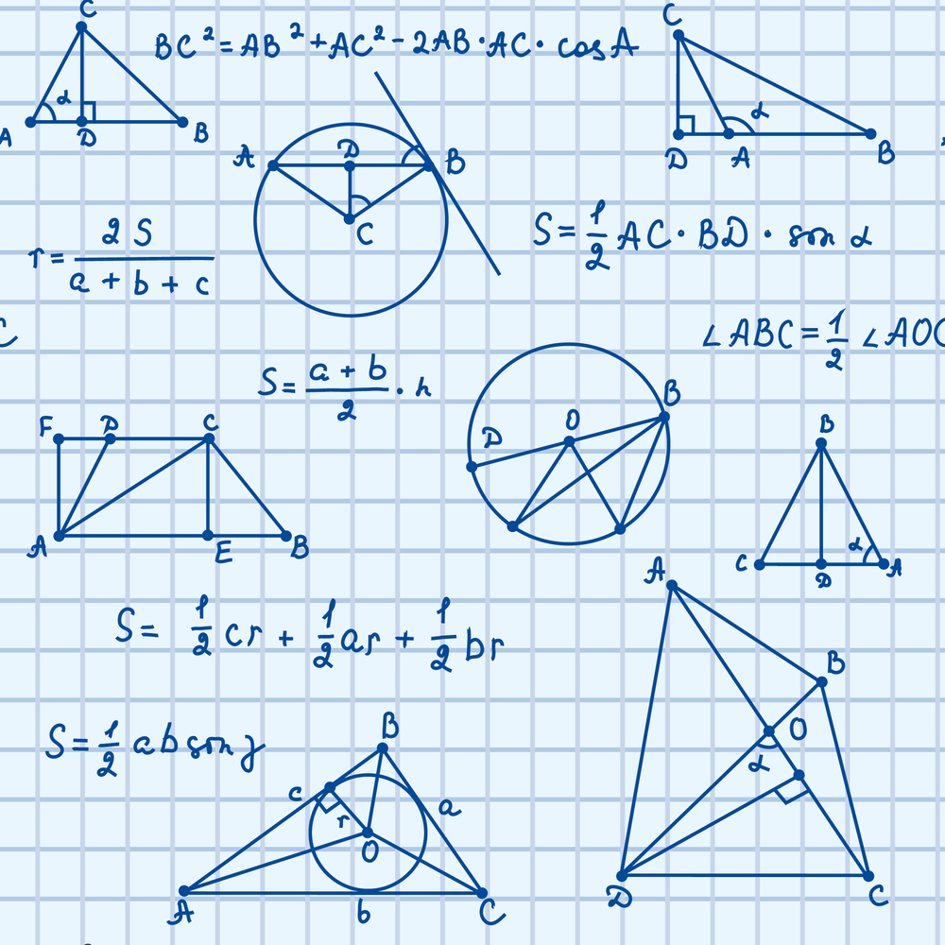
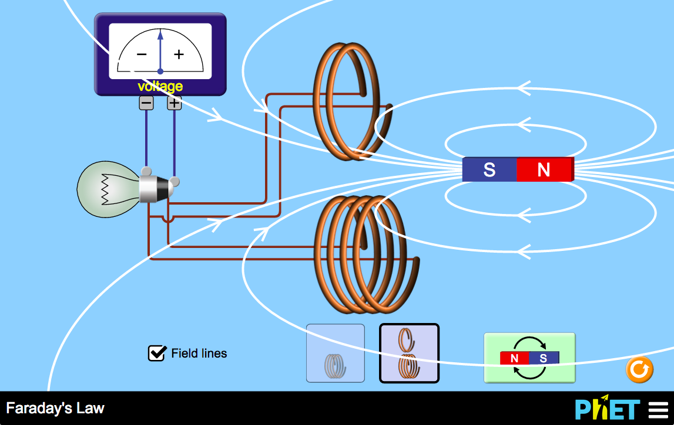
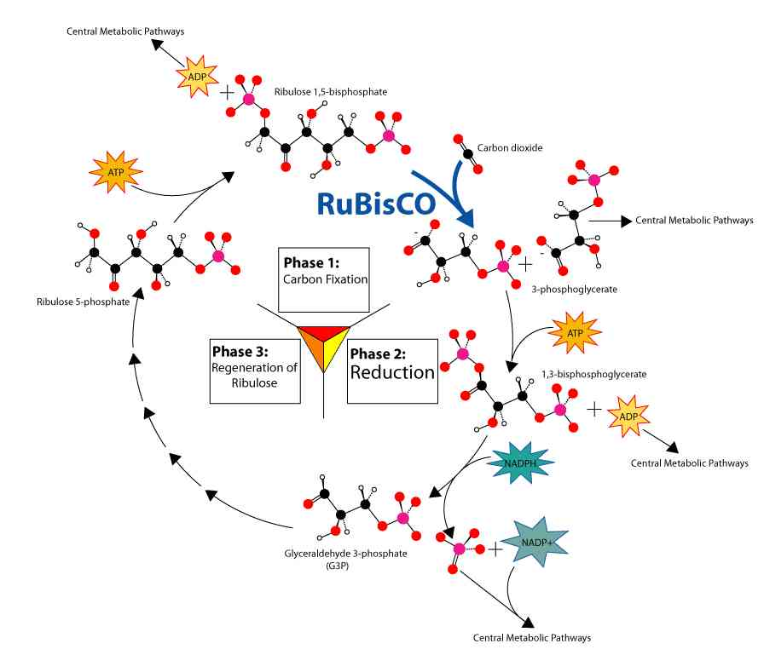
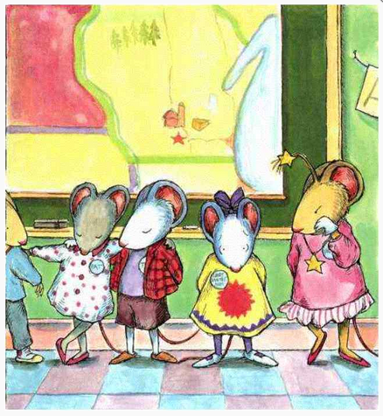
Making STEM Accessible for All Learners
Notes:
So much complexity and variety when it comes to educational content
Images, diagrams, videos – lots of content on the web; hard to locate desired content (standardized metadata for search)
Math diagrams & equations – content involving specialized markup is a problem for all learners in the digital world
Videos, interactives, VR, and more – requires advanced technology infrastructure & tools
3D technology & alternatives for teaching – UDL & need to cater to different learning styles

Slide 12

Labs

Slide 13
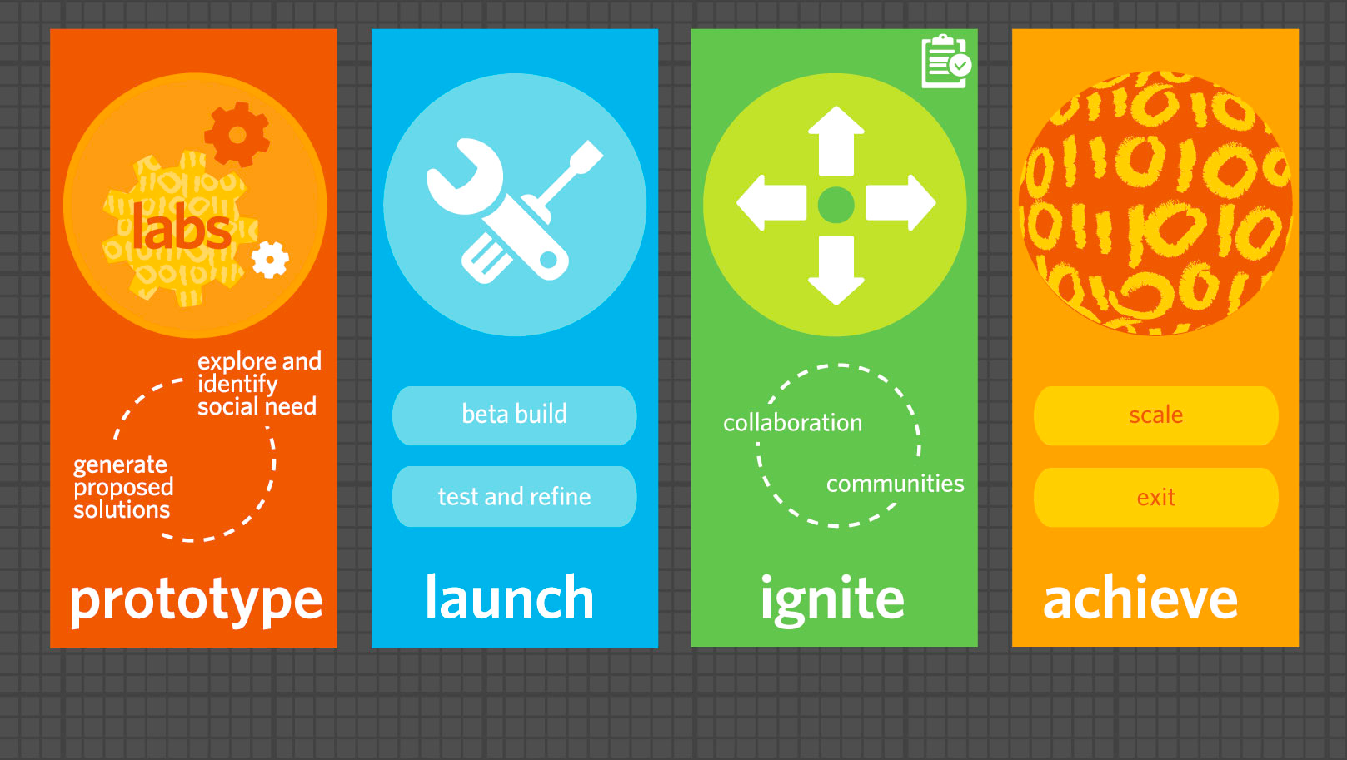
Benetech Labs Mission
To openly and directly experiment with and catalyze high-impact social good tech with a pathway to scale, to harness a community of doers to become the leading place where open innovation meets social empowerment so bold ideas can change the world.

Slide 14

Inclusive Math
Up to 35% students struggle with math
4-14% identified learning disability in mathematics*
Notes:
https://council-for-learning-disabilities.org/wp-content/uploads/2014/12/Math_Disabilities_Support.pdf
4-8% + 2.7

Slide 15
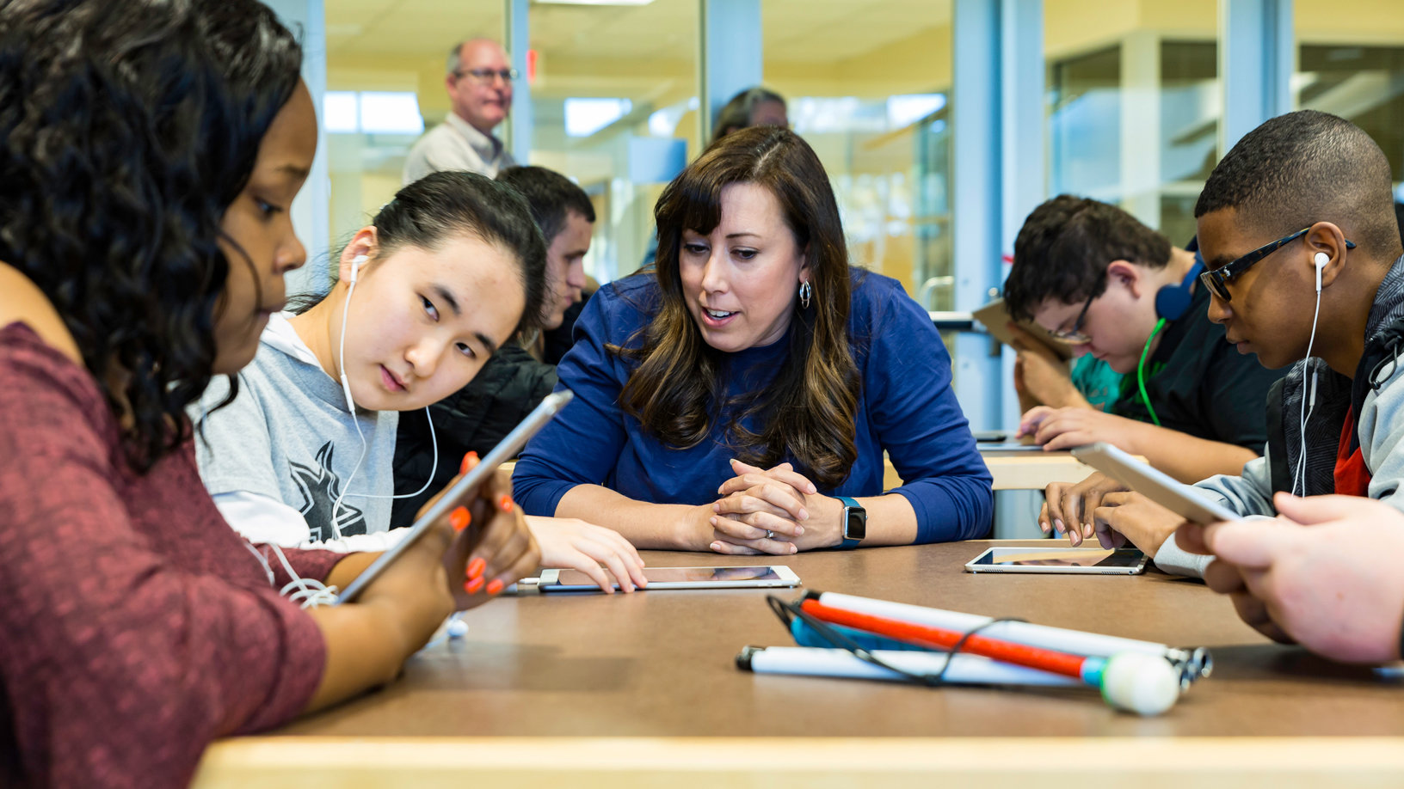
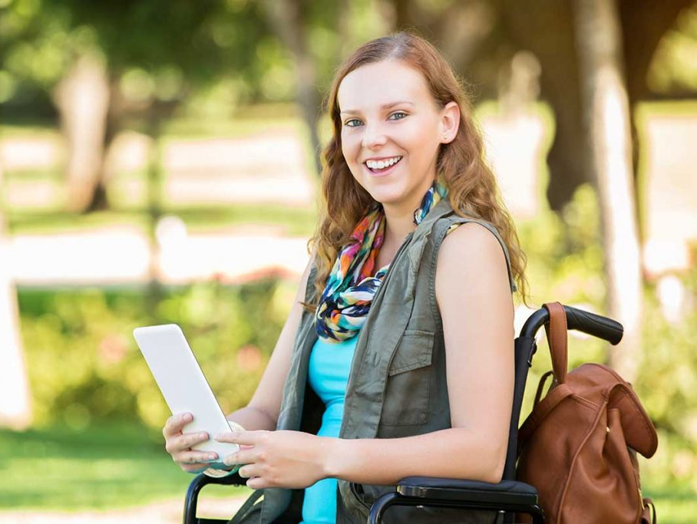
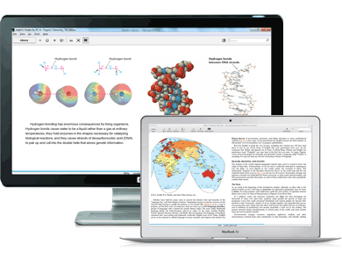
Bentech Mathshare
An inclusive tool that helps students show, share and organize their work
Helping teachers work one on one with students in a blended and inclusive classroom
Students working independently at home, on the bus, or at school
Embedded within existing and new digital curriculum

Slide 16
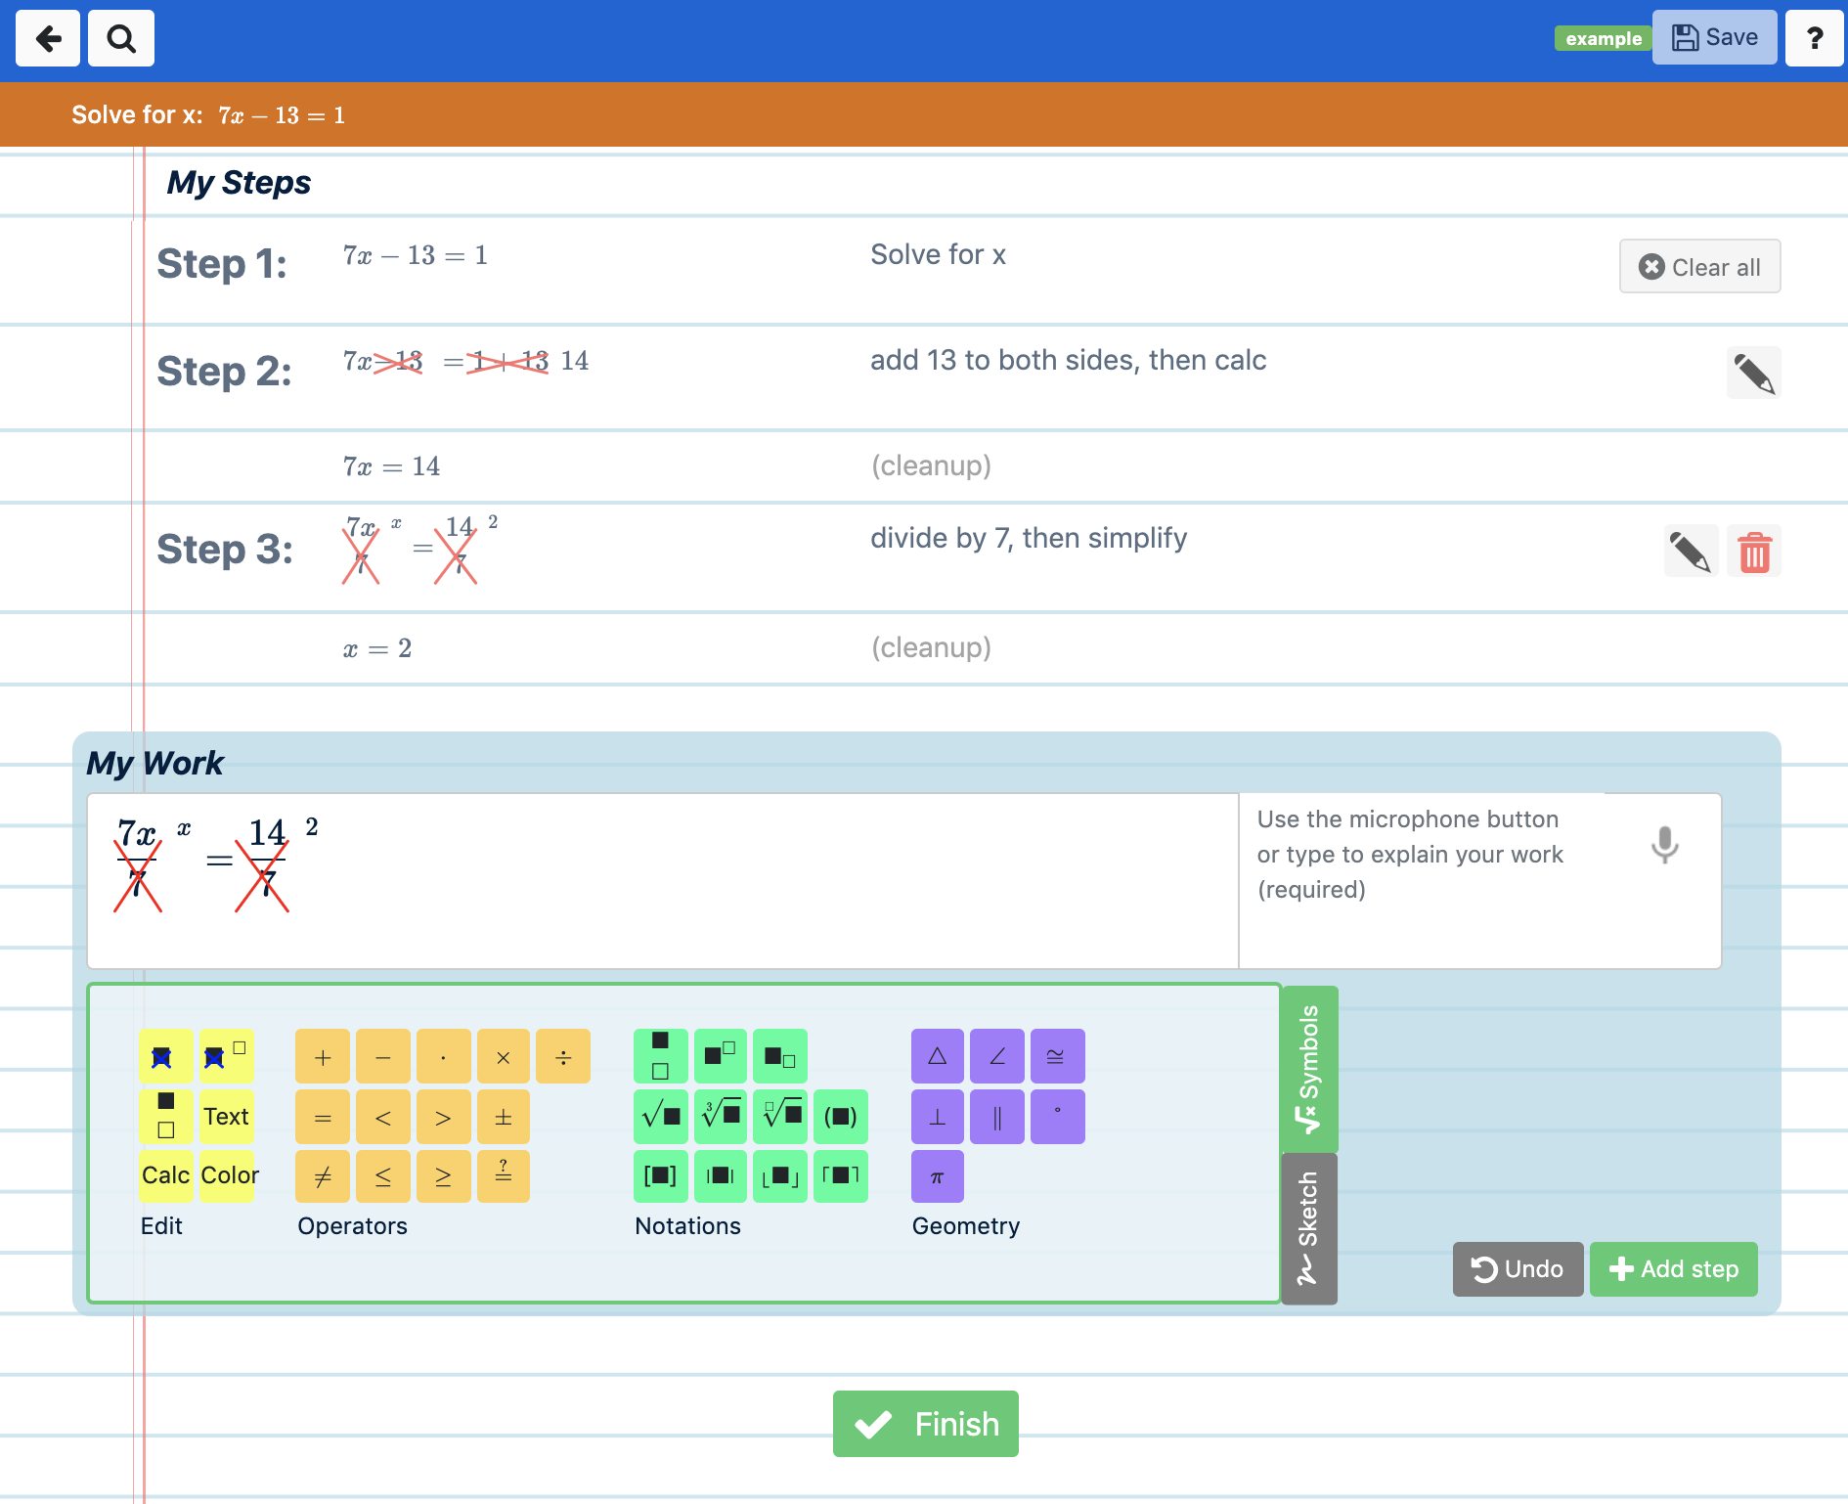
Mathshare

Slide 17
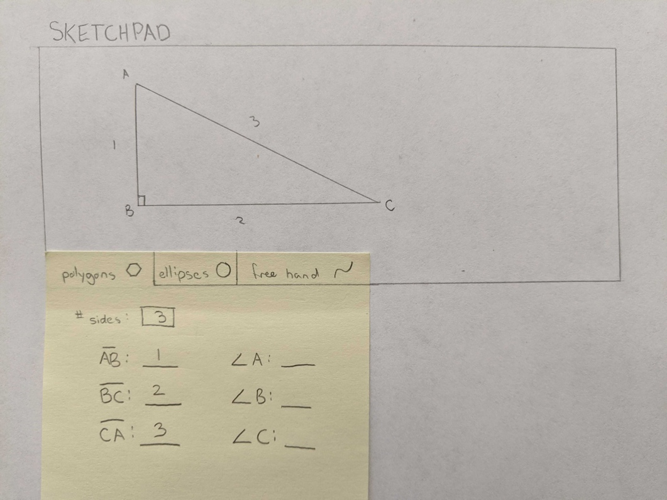
Hackathon IDEA: Accessible Math Sketchpad
GitHub: https://tinyurl.com/ugptajd
Challenge: Create a web-based Accessible Sketchpad that will draw basic geometric shapes based on users input and done in such a way that students can explore the image created in an accessible way!

Slide 18
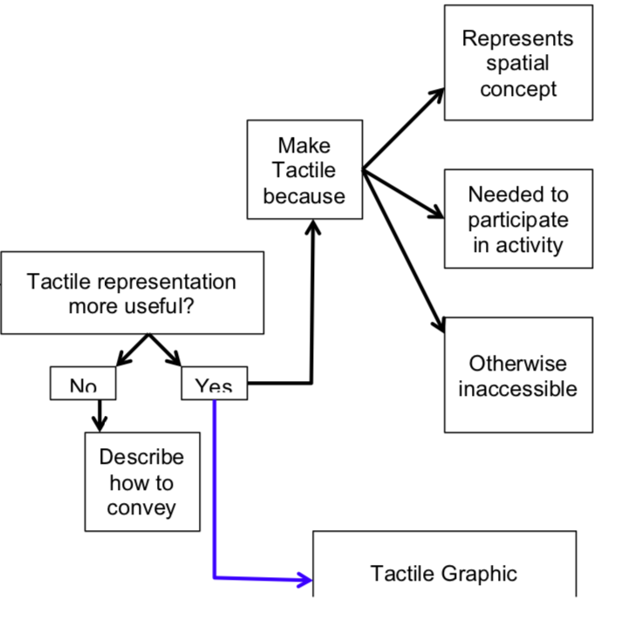
Hackathon IDEA: Accessible Survey Logic
GitHub: https://tinyurl.com/rd6wwbl
Complex surveys that use branching logic based on the answer of a previous question are inaccessible to users that require assistive technology. We need an assessible option!

